Slide 1
SAMPLING METHODOLOGY
IB CHEMISTRY/IB PHYSICS GROUP INVESTIGATION PROJECT

Slide 2
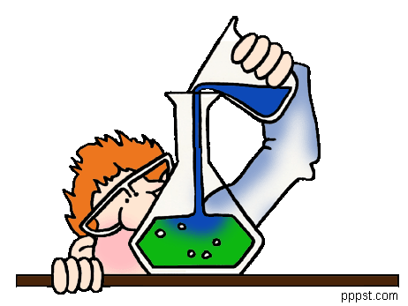
INITIAL PREPARATION
Before samples are collected, all sampling equipment must be cleaned in a laboratory using detergent followed by di water.
Sampling equipment must be non-metallic and free from any materials containing metals or any of the contaminants being tested.

Slide 3
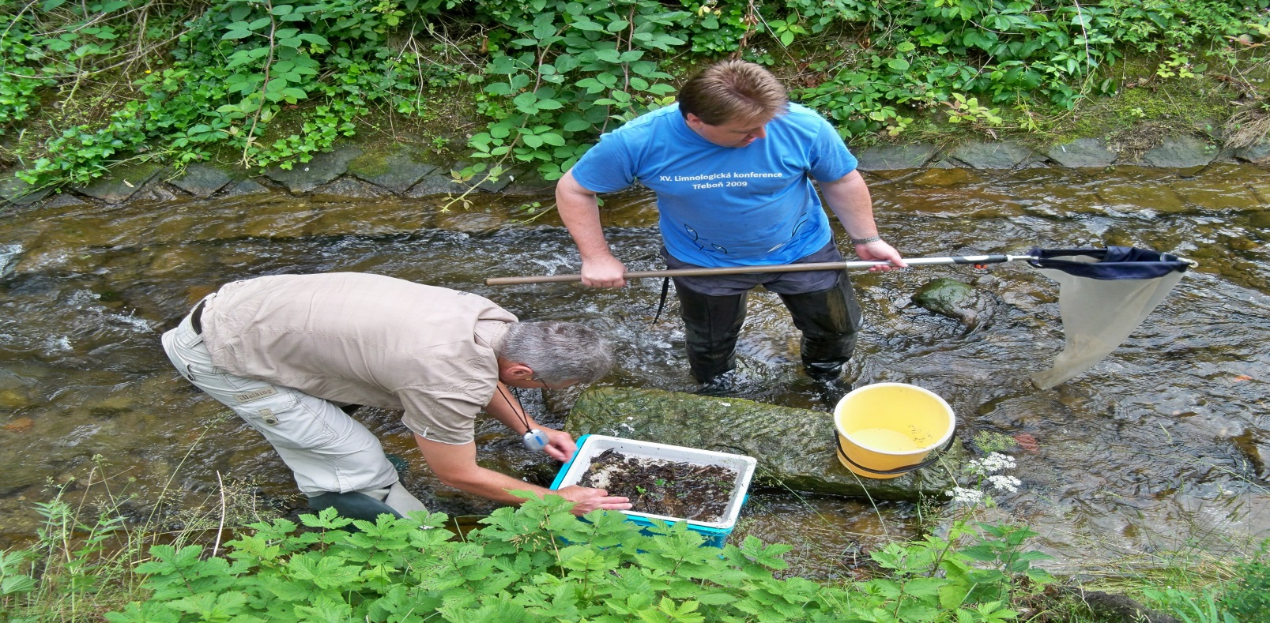
ARRIVAL AT THE SAMPLING SITE
Upon arrival at the sampling site, one person is designated as “dirty hands” and the other person is designated as “clean hands”.
All operations involving contact with the sample bottle and transfer of the sample into the sample bottle are handled by the individual designated as “clean hands”.
All other activities that do not involve direct contact with the sample is handled by “dirty hands”.

Slide 4
SAMPLING ATTIRE
All sampling personnel are required to wear clean, non-talc gloves at all times when handling sampling equipment and sample containers.
Only clean gloves should touch the sampling apparatus. If you suspect the gloves are contaminated, replace them.

Slide 5
SELECTION OF SAMPLING SITES
The sample site should exhibit a high degree of cross-sectional sampling.
Sample sites should be as far away as possible from any metal supports, bridges, wires, or poles.
Samples should be collected as far as possible from heavily travelled roads and roads that have dust.

Slide 6
SAMPLING METHODS
Whenever possible, samples are collected facing upstream and upwind to minimize introduction of contamination.
Samples must be collected while working from a boat or from on land.
Surface samples are collected using a grab sampling technique.
This technique involves filling a sample bottle by rapid immersion in water and capping to minimize exposure to airborne particulate matter.

Slide 7
MINIMIZING CONTAMINATION
Be aware of potential sources of contamination.
Pay strict attention to work being performed.
Minimize exposure of the apparatus to outside contamination. Be aware of routes of contamination within your sampling area.

Slide 8
LABELLING
GROUP#/SAMPLE #
ZONE
OBSERVATIONS
SAMPLING PROBLEMS

