Slide 1
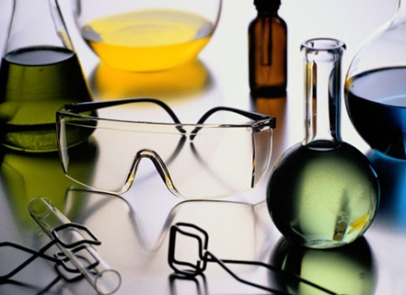
Lab Safety, Symbols & Equipment
Packet #2

Slide 2
Chemical Symbols
Symbols Located on Chemicals

Slide 3
Chemical Symbols I
Yellow
Reactivity

Slide 4
Chemical Symbols II
Red
Severe Hazard/Flammability

Slide 5
Chemical Symbols III
Blue
Health

Slide 6
Chemical Symbols IV
White
Special Hazard

Slide 7
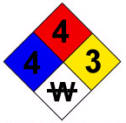
NFPA CHEMICAL HAZARD LABEL
Burns readily.
Diborane
May detonate with heat or ignition.
Severe health risk.
Avoid water.

Slide 8
MSDS

Slide 9
MSDS I
Material Safety Data Sheet
On file for all purchased chemicals
Includes information on chemical label
Different formats are used by different companies

Slide 10
MSDS II Example

Slide 11
Laboratory Safety Symbols

Slide 12
Laboratory Safety Symbols I
Students should be familiar with all symbols

Slide 13
Laboratory Safety Symbols II
Students should be familiar with all symbols.

Slide 14
Laboratory Safety Symbols III
Students should be familiar with all symbols.

Slide 15
Lab Safety Rules

Slide 16
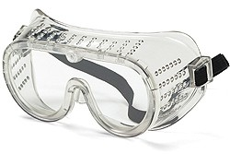
Goggles
Students are required to wear safety goggles at all times during lab exercises.
Failure to wear safety goggles could result in chemical burns of the eye.

Slide 17
Hair
Hair must be tied during lab exercises.

Slide 18
No Backpacks
Backpacks and purses are not allowed in the lab area.

Slide 19
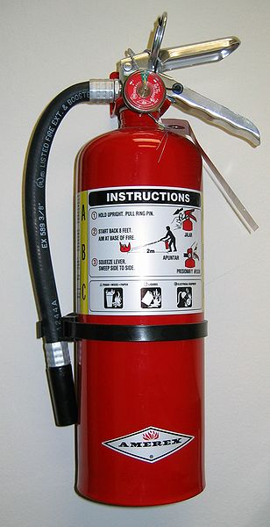
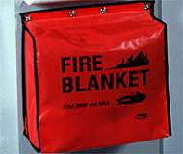
Things to Know…
Know the locations of
Eyewash
Fire Blanket
Fire Extinguisher

Slide 20
No Horseplay
No horseplay in the lab area!

Slide 21
No Food/Drink
No food or drink in the lab area.

Slide 22
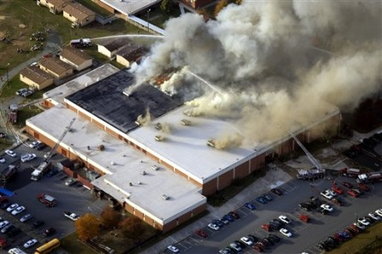
No…
No unauthorized experiments!

Slide 23
Removal of Lab Equipment
Never remove chemicals or lab equipment from lab.

Slide 24
Unlabeled Containers…
Never use chemicals from an unlabeled container.

Slide 25
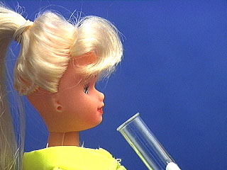
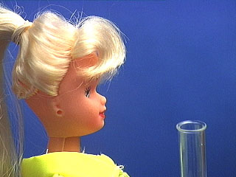
Heating Test Tubes
NEVER point the mouth of a test tube or Erlenmeyer flask at yourself or another person!
ALWAYS direct the mouth away from people!
Wrong!
Correct!

Slide 26
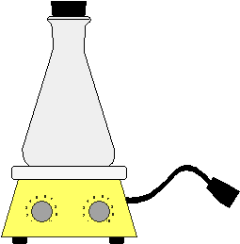
Heating Containers…
Never heat a closed container.
Pressure in container increases and can cause chemicals to spray out from the top or cause the contained to shatter spreading shards of glass.

Slide 27
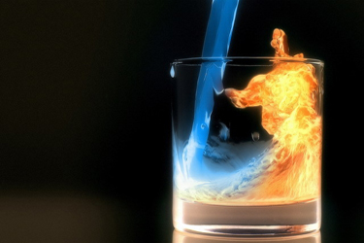
Flammable Substances
Keep ALL flammable substances from heat sources/open flames.
Never heat a liquid in a test tube over an open flame; use a water bath.
Never use flames near combustible materials.
Use fume hoods as directed.

Slide 28
Spills…
Immediately clean up any chemicals that you spill.
Never return spilled or unused material to the reagent bottle.
Solids should be swept up and placed in the proper was disposal container for that lab.
Small liquid spills should be diluted with lots of water and mopped up with cloth towel.
Large spills must be handled by the instructor.

Slide 29
Caution with Strong Chemicals
Observe caution in using strong chemicals.
Never pour water into concentrated acids; dilute an acid by pouring the acid slowly and carefully into the water with constant stirring.
Use caution in mixing strong acids and bases.

Slide 30
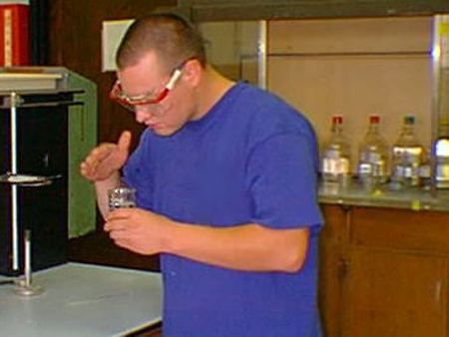
Smelling Chemicals
When it is necessary to smell chemicals in the lab, the proper technique is to cup your hand above the container and waft the air toward your face.
Try not to breathe in the air through your nose, but bring in just enough to make sense of the smell.

Slide 31
Injuries

Slide 32
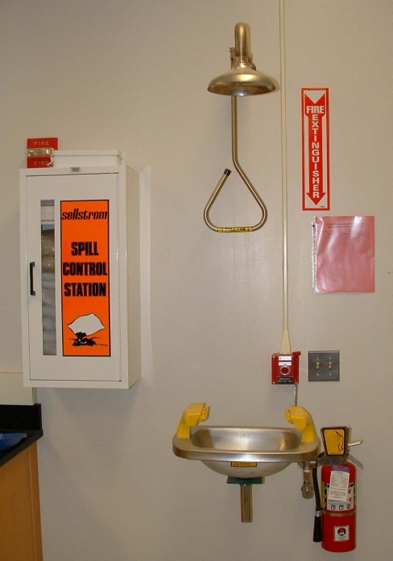
First Aid…Begin Immediately
Alert the instructor immediately!
If chemicals have come in contact with the eyes, begin eyewashing NOW!
Remove clothes that have chemical contamination
Move everyone away from the area to avoid further contamination

Slide 33
Injuries…
Chemical spills anywhere on the body:
Flush the area immediately with large volumes of water from the nearest faucet.
Remove contaminated clothing if necessary. Use no medication on the injury, but bandage and obtain medical attention if necessary.
Eyes
Hold the eyes open while flushing for at least 15 minutes at eyewash stations. Obtain medical help immediately.
Concentrated acids or bases spilled over a large body area.
Use a safety shower, then obtain medical help.

Slide 34
Fire I
Fire:
Extinguish all burners, remove flammable solvents from the immediate vicinity, and have all people not involved in fighting the fire leave the laboratory by the nearest exit.
Do not attempt to fight a major fire.
Pull the building alarm, shut the windows and fire doors, and leave by the nearest exit.

Slide 35
Fire II
Clothing on fire:
Prevent the victim from running.
Have the victim lie down, and smother the flames with available clothing, a fire blanket, or by rolling the victim around on the ground.
Towels, books, or other items aflame can be put or pushed in the sink with tongs and doused with water.

Slide 36
Fire III/Burns
Burns:
Apply no medication to major burns.
Cover the area with a sterile dressing and obtain medical help immediately.
For minor burns, immerse in cold water and bandage when comfortable.

Slide 37
Cuts & Punctures
Clean your hands and the victim's wound with soap and water, and remove any glass slivers from the wound.
Apply a sterile dressing, and control any severe bleeding by applying pressure directly over the wound.
Apply no medication.
Always obtain medical attention for punctures or severe cuts because of the possibility of tetanus.

Slide 38
Basic Laboratory Equipment

Slide 39
Laboratory Equipment I
Students should be familiar with all laboratory equipment.

Slide 40
Laboratory Equipment II
Students should be familiar with all laboratory equipment.

Slide 41
Laboratory Equipment III
Students should be familiar with all laboratory equipment.

Slide 42
Review

